Slide 1
Development of an Online Tool for the Creation and Analysis of Feature Models for Software Product Lines
Harry Scutt
Supervisor: Dr José Miguel Rojas
COM3610 Dissertation Project

Slide 2
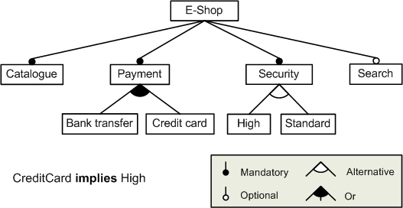
Software Product Lines:
Feature Models:
Describe a family of similar systems
Systems comprise of modular components that can be configured to fit needs
Help reduce development time and lifecycle costs
Emphasise reusability and robustness
Can reduce frequency of bugs in a software family
Leads to increased developer productivity
Product lines often represented as a Feature Model (right)
Help clearly communicate the relationships and constraints between components
Enable simple visual check for completeness
Reduce the level of technical knowledge required to understand the product family – suitable for clients
Enable analysis to be run on a product line, providing insight into the scope of a product family

Slide 3
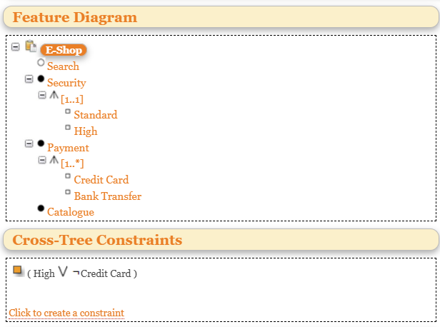
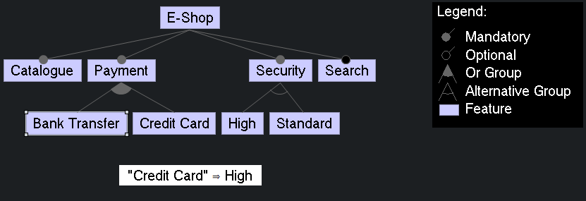
Existing Solutions
SPLOT:
Most popular solution
Features large database of feature models
Unintuitive and clunky to use
Hasn’t been maintained since ~2015
Web-based
FeatureIDE:
Tailored to developers
Enables the generation of software from a product configuration
More intuitive, but more difficult to access
Diagrammatic representation of model
Eclipse IDE extension
E-Shop diagram from the previous slide recreated in Feature IDE
E-Shop diagram from the previous slide recreated in SPLOT

Slide 4
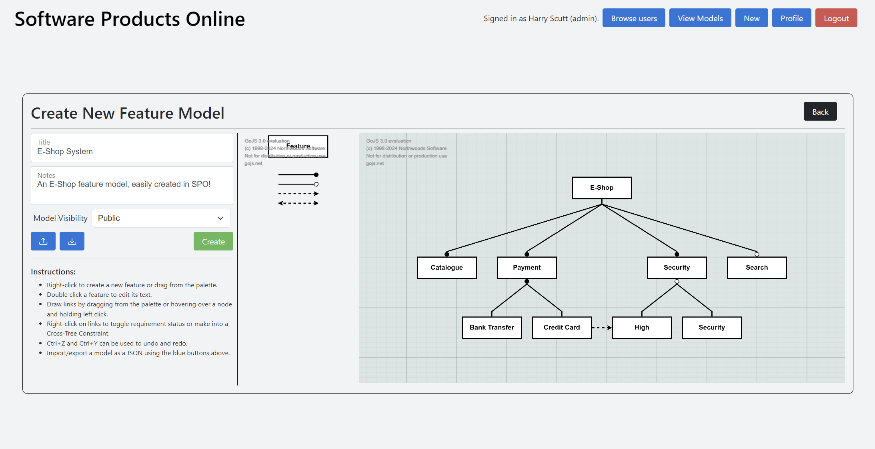
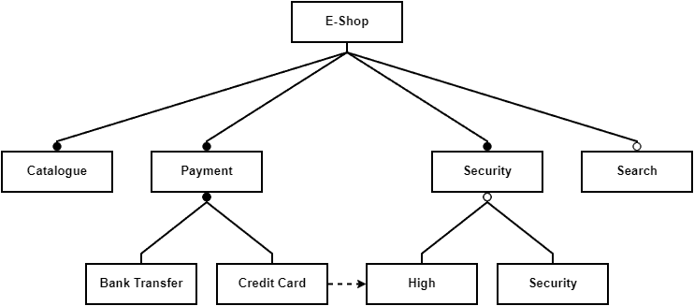
Software Products Online:
Intuitive diagram builder
Easily accessible web application
Can use as guest or member
Integrated feature model sharing
Feature model analysis
Export models as SVG, JPEG, or JSON for sharing outside the application
E-Shop diagram from the first slide exported as a JPEG from SPO

Slide 5
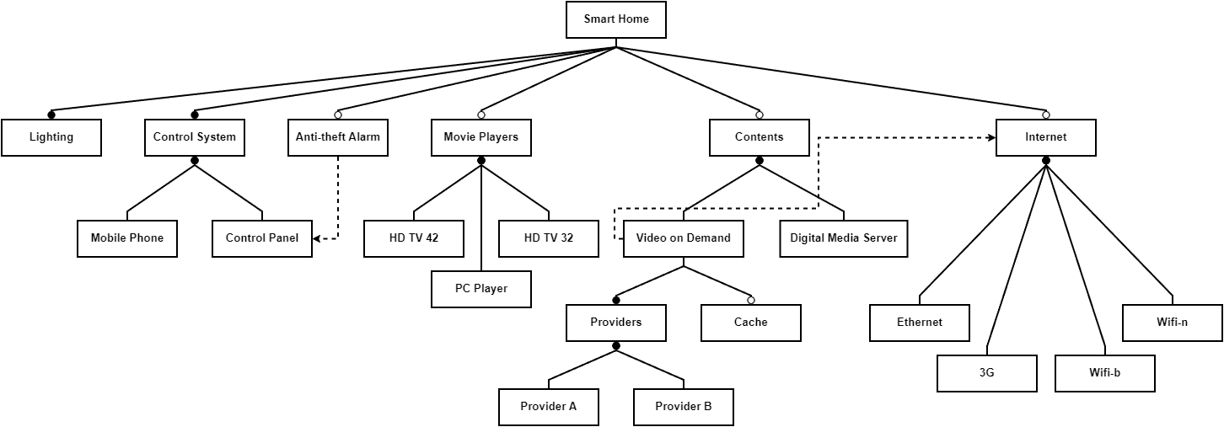
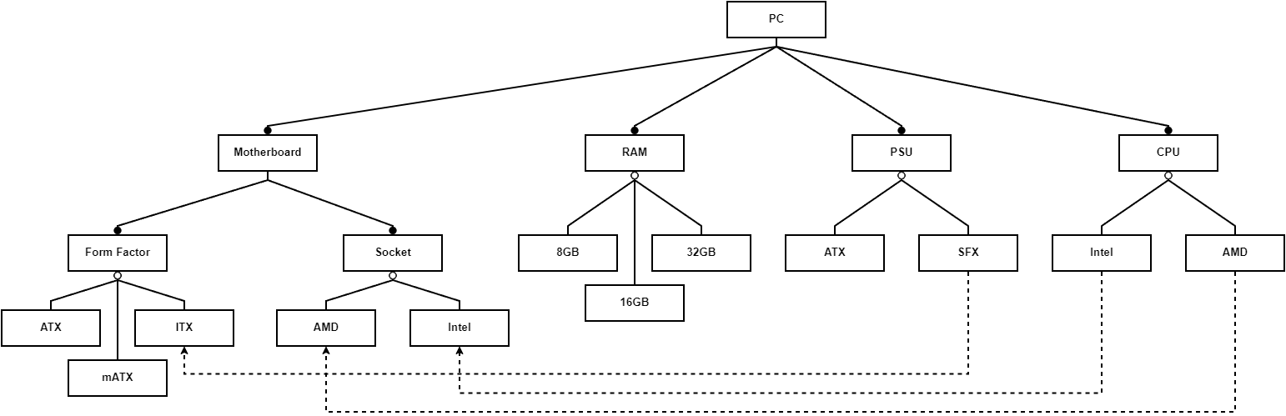
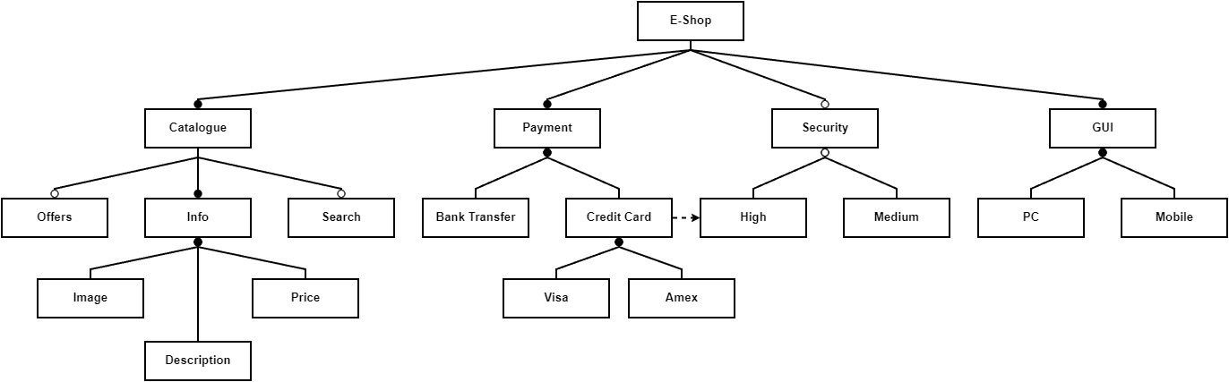
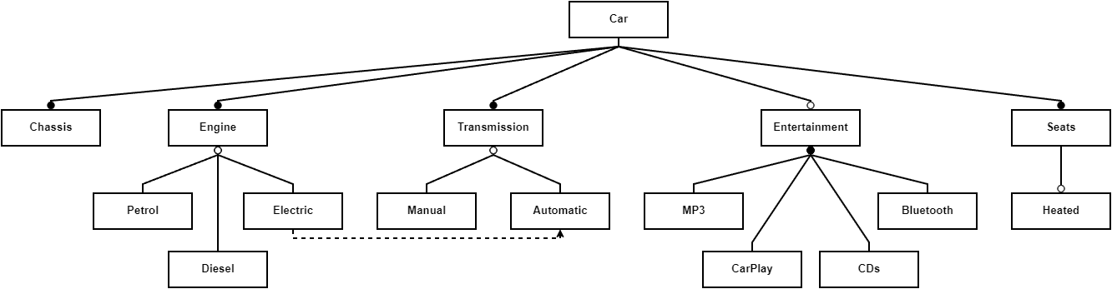
Feature models created in SPO:

Slide 6
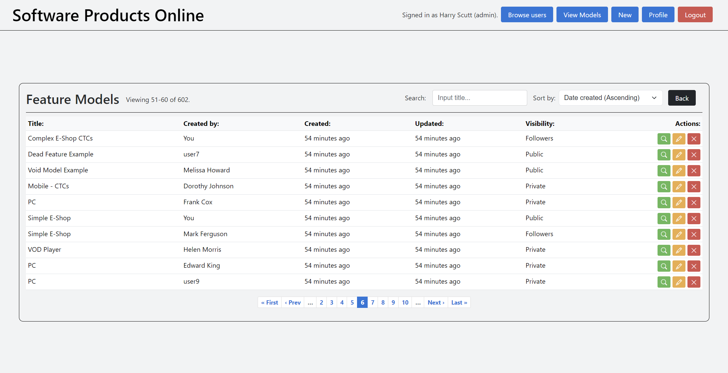
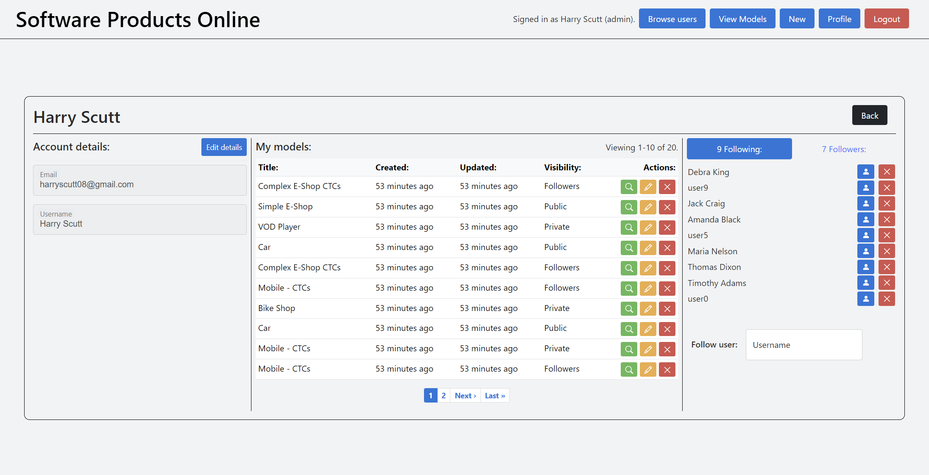
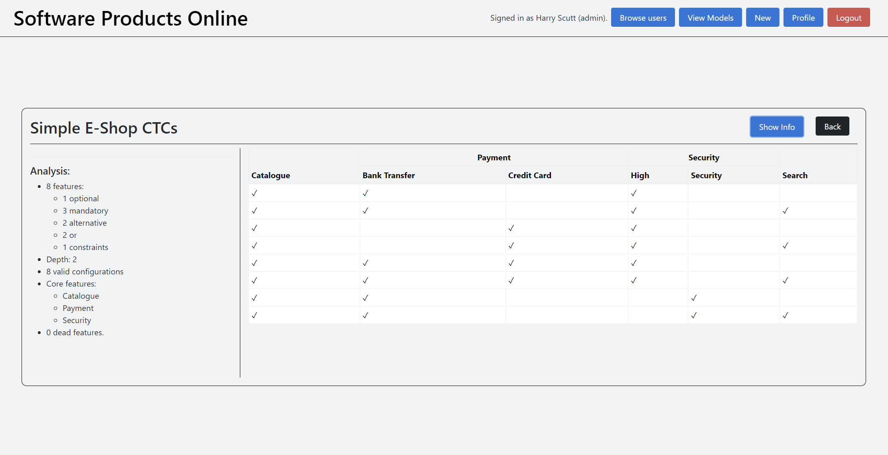
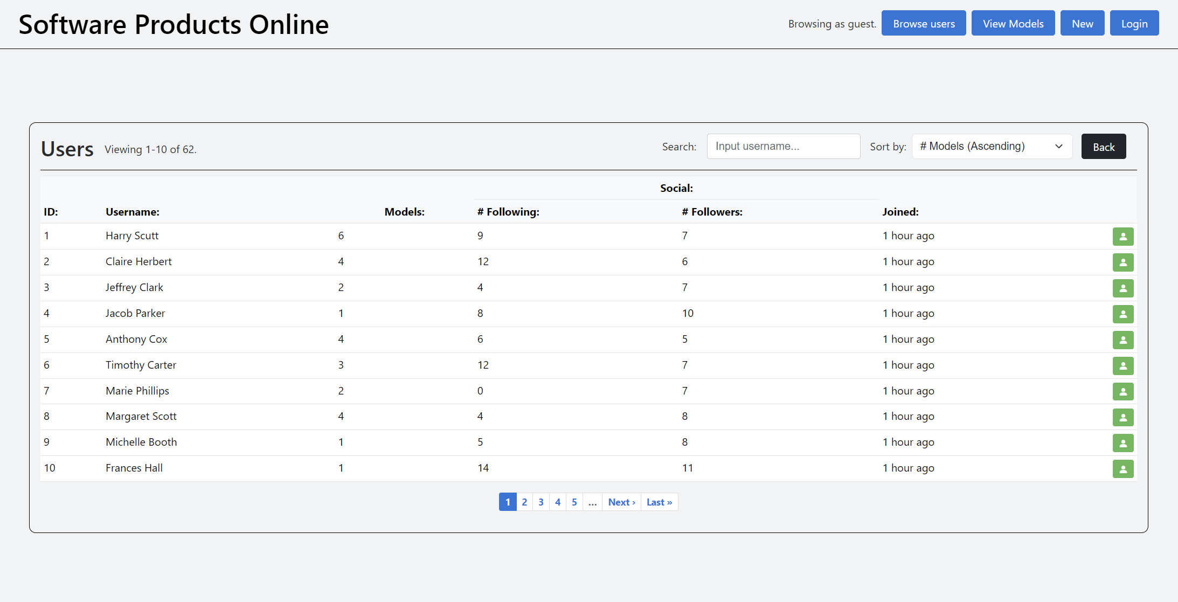
Usage screenshots:

